Slide 1

Cuckoo-Inspired Algorithms

Slide 2
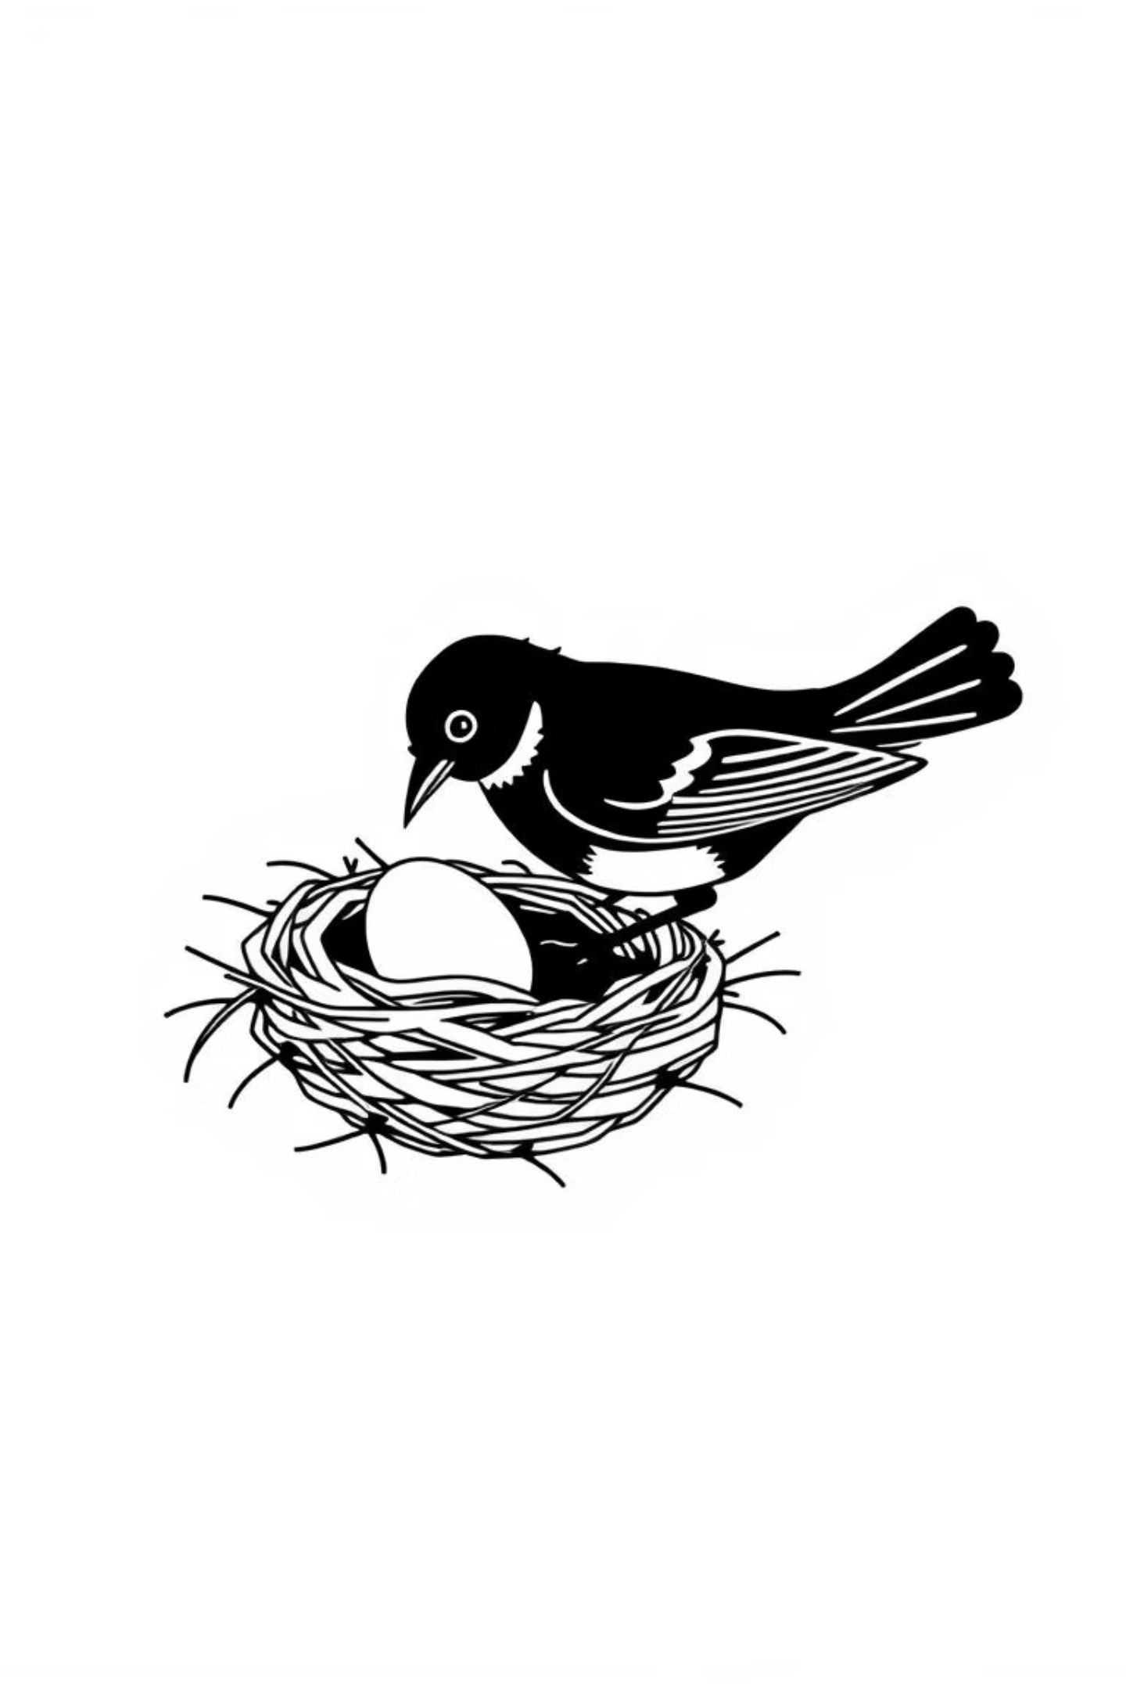
Inspiration for Cuckoo Search Algorithm
Cuckoo Search is an optimization algorithm inspired by the brood parasitism of certain cuckoo species that lay their eggs in the nests of other birds. The cuckoo egg usually hatches earlier, and the chick often pushes out the host’s eggs to eliminate competition. If the host bird detects the foreign egg, it may reject it or abandon the nest. Cuckoo search idealized such breeding behavior, and thus can be applied for various optimization problems

Slide 3
The Cuckoo Search Algorithm (CSA) Basics
Core Concept
1
Nests represent potential solutions to a problem. A new cuckoo egg represents a new, potentially superior solution.
Solution Mapping
2
A cuckoo generates a new solution by performing a Lévy flight and then replaces a potentially worse solution in a randomly chosen nest.
Selection Mechanism
3
A fraction of the worst nests are abandoned and replaced by new, randomly generated ones. This is analogous to a host bird discovering and discarding a cuckoo egg, forcing it to start over in a new location.
Discovery & Diversity
4
Host birds discover and discard alien eggs with probabilistic accuracy, introducing crucial population diversity.
Elitism
5
The best solutions are carried over to the next generation to ensure that the algorithm does not lose its progress.

Slide 4
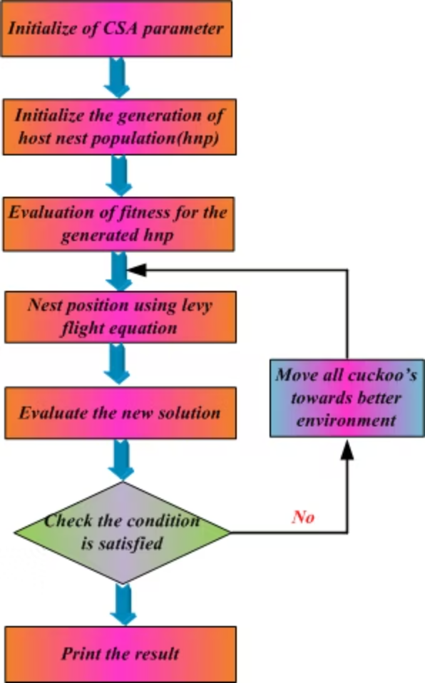
Cuckoo Search Algorithm (CSA) Process Flow
Set up the algorithm's basic settings (like number of nests, probability of discovering alien eggs, step size, etc.).
Randomly create an initial set of possible solutions, each represented as a "nest."
Measure how good each solution (nest) is according to the problem's objective function.
Cuckoos lay new eggs (create new solutions) using Lévy flights, which are random walks that explore the search space widely.
Check how good these new "eggs" (solutions) are.
Check if the stopping condition is met – if the algorithm has reached the desired accuracy or maximum iterations, stop. Otherwise, repeat the loop.
Replace poor solutions with better ones, mimicking how cuckoos choose the best nests for survival.
Print the result – show the best solution found.
In short, the algorithm keeps improving solutions by imitating cuckoos' strategy of laying eggs in the best nests until an optimal or near-optimal answer is found.

Slide 5

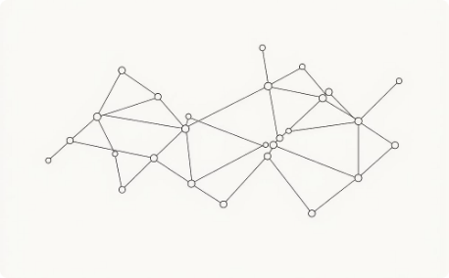
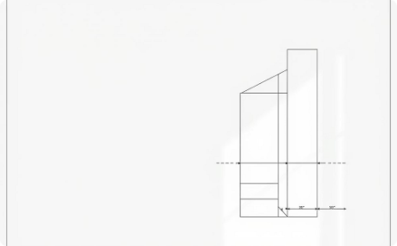

Real-World Applications: From Healthcare to Engineering
Healthcare Diagnostics
Cybersecurity
Engineering Design
Industrial Optimization
CSA-driven feature selection dramatically improves diabetes prediction accuracy and early disease detection.
CSA-based feature selection detects network attacks and intrusions with enhanced precision and reduced false alarms.
Multi-objective CSA discovers optimal structural parameters, simultaneously reducing manufacturing cost and design error.
CSA optimizes production schedules, resource allocation, and quality control across manufacturing systems.

Slide 6
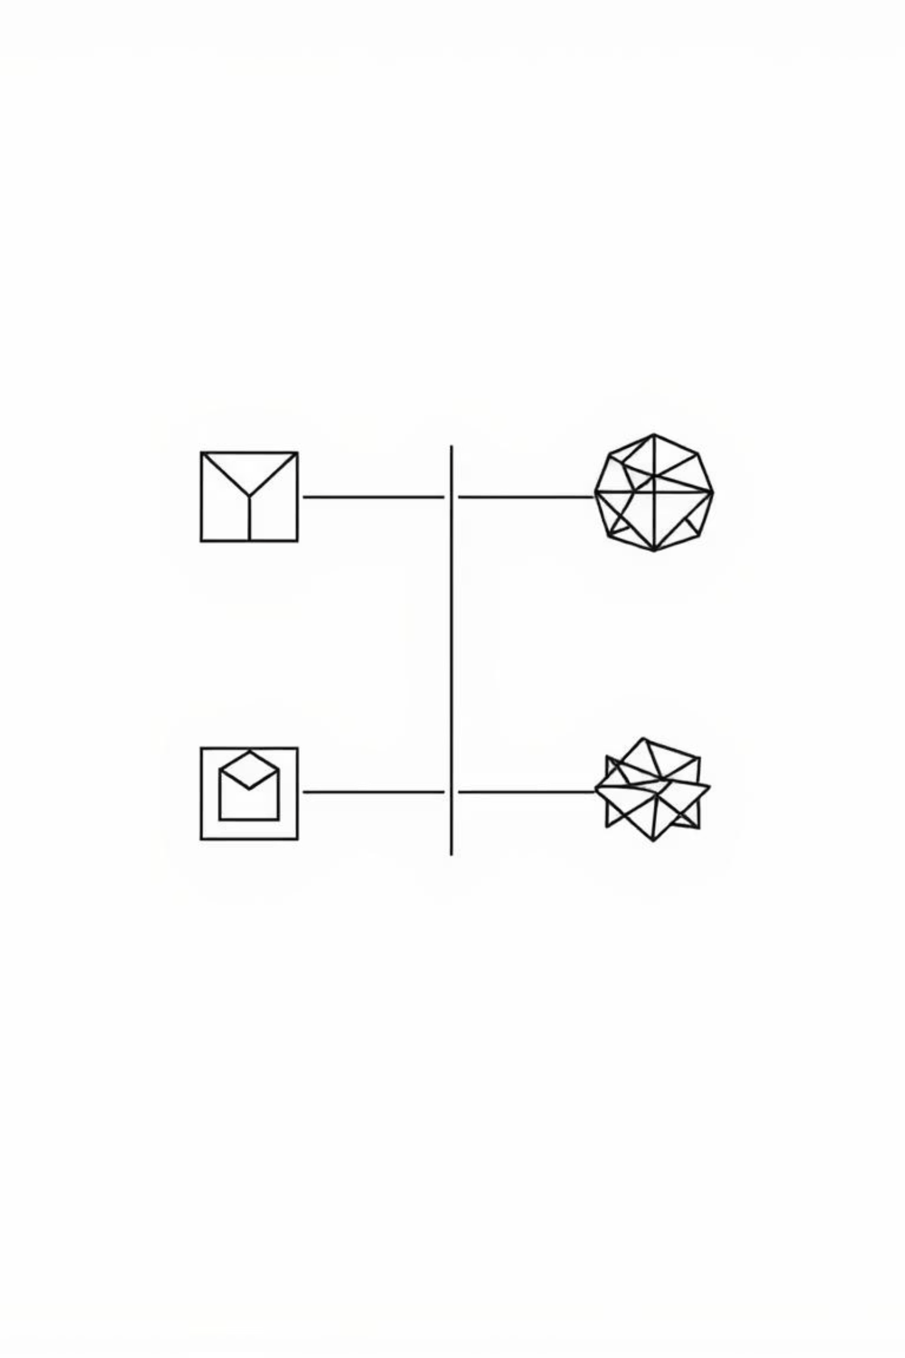
Key Improvements & Variants
Modified Cuckoo Search (MCS)
Multi-Objective CSA (MOCS)
Incorporates elitism principles and chaos theory to accelerate convergence and improve stability.
Simultaneously optimizes conflicting goals using Pareto optimality for complex real-world problems.
Hybrid Approaches
Combines CSA with Particle Swarm, Genetic Algorithms, or Fuzzy Logic for enhanced performance and robustness.

Slide 7





Key Advantages of Cuckoo Search Algorithms
Cuckoo-inspired algorithms offer elegant, powerful solutions to complex optimization challenges that resist traditional approaches.
Simplicity
Remarkable Adaptability
Minimal parameters with maximum algorithmic power
Easily hybridized and modified for specialized domains
Innovation Promise
Rising Star Status
Breakthroughs across science, engineering, and technology ahead
Growing prominence in metaheuristic research and applications

Slide 8
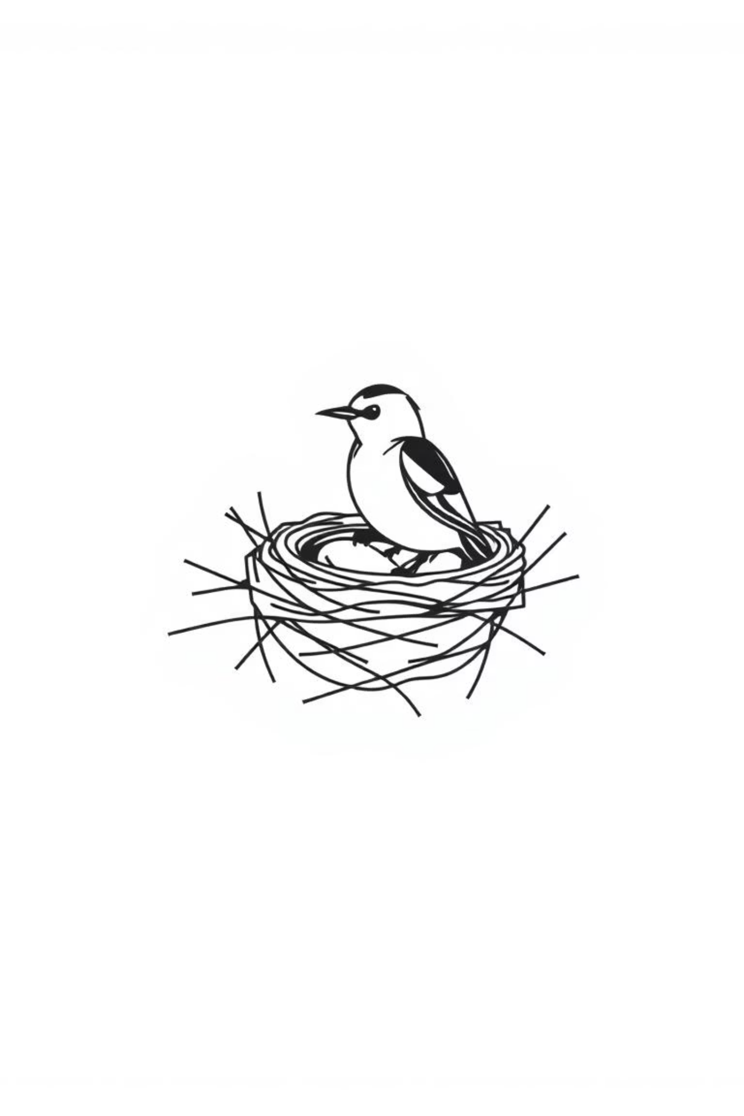
Thank You for Your Attention!
Questions & Discussion Welcome

