Slide 1
Particle Swarm Optimization Algorithm
Boumerah Nour El Houda

Slide 2
01
Introduction
02
How It Works
03
Simple Example
Table of contents
04
Applications
05
History & Development
06
Analyzing Results
07
Strengths and Weaknesses
08
Conclusion

Slide 3

Introduction
Have you ever watched how birds fly together or fish swim in groups?
They move in harmony and often find food faster when they cooperate.
Particle Swarm Optimization (PSO) is an algorithm inspired by this behavior.
It helps computers find the best solution to a problem by imitating how a swarm learns and adapts.
Particle Swarm Optimization (PSO)

Slide 4
How It Works
Each possible solution is called a particle.
All particles together form a swarm.
Each particle has:
A position (a possible answer),
A velocity (how it moves),
A memory of its best position (pBest).
The swarm also knows the best position overall (gBest).
Then, every particle moves:
partly toward its own best,
partly toward the group’s best.
Step by step, the swarm gathers near the best solution —
just like birds finding the lowest valley.

Slide 5
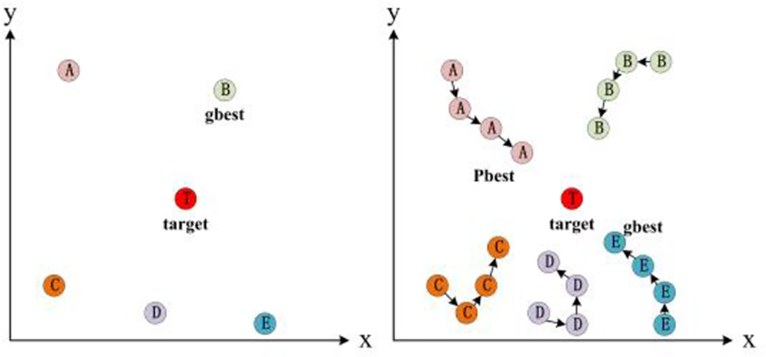
How the swarm moves step by step toward the goal

Slide 6
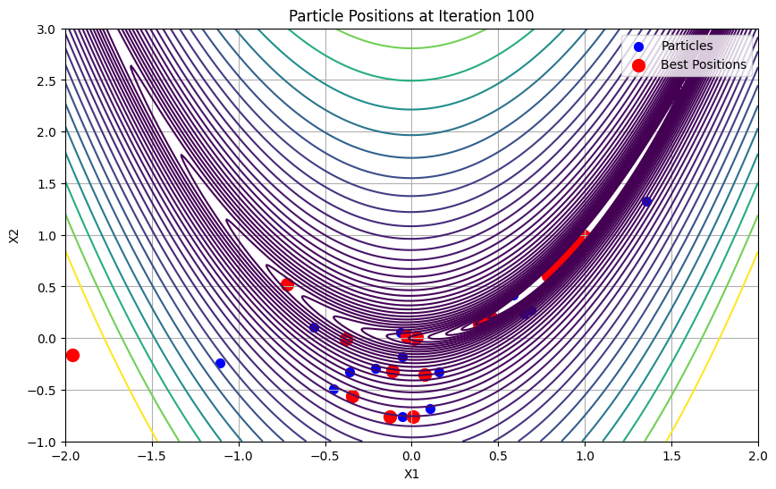
Simple Example
Let’s minimize this function:
f ( x ) = ( x − 3 ) ²
If the particles start at x = 1, 5, and 8, they move closer to x = 3, because that’s where f(x) is smallest.
That’s how PSO “learns” — by adjusting positions until the best value is found.

Slide 7
Engineering
Robotics
Applications
AI
Economics
Medicine
Designing aircraft or circuits
Controlling drone swarms
Training neural networks
PSO is used in many real-life problems:
Optimizing investments
Improving image analysis

Slide 8
History and Development of PSO Algorithm
2004–2010
Hybrid Approaches
1995
The Origin
PSO was combined with other algorithms (like Genetic Algorithms and Neural Networks).
PSO was first introduced by James Kennedy and Russell Eberhart, inspired by bird flocking and fish schooling.
2015–Today
Modern Applications
1998–2002
Early Improvements
Widely used in AI, robotics, engineering, and data optimization — faster and smarter versions now exist.
Researchers improved PSO’s formulas for velocity and convergence, making it more stable.

Slide 9
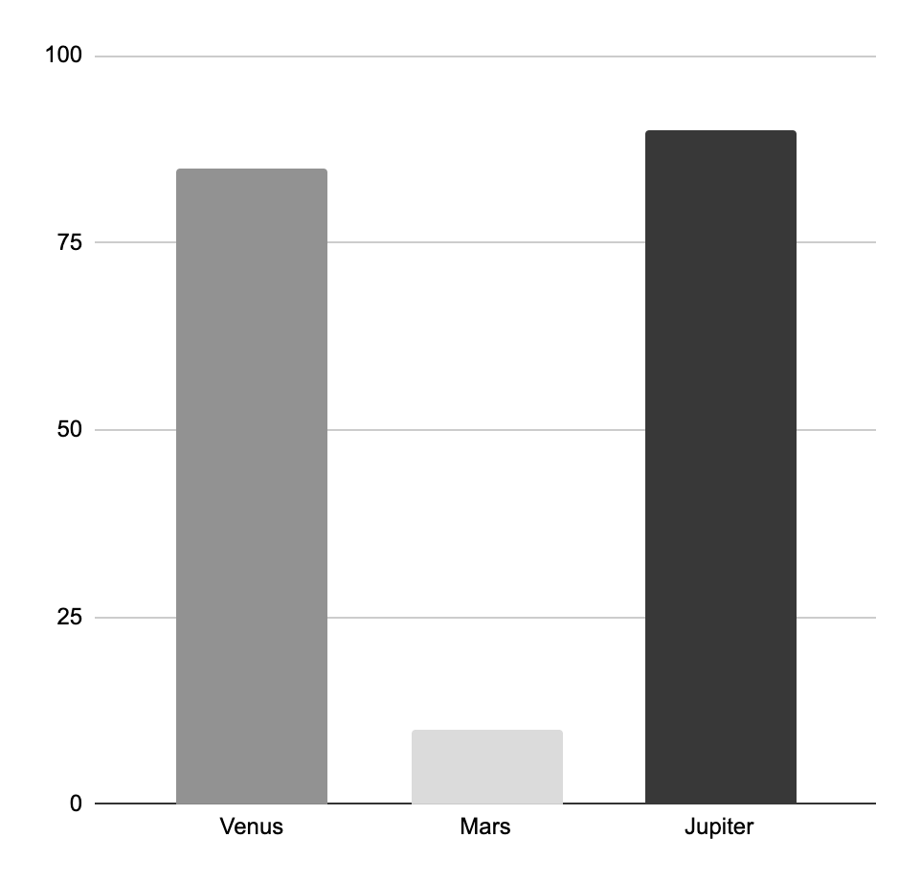
Analyzing Results of PSO Simulation
Accuracy
How close the result is to the optimal solution
92%
85%
85%
Success Rate
Converg-
ence Speed
300
Iterations
How fast the swarm finds a good solution
10%
0.02 s
Stability
Avg time
How consistent results are in repeated runs
The PSO algorithm reached high accuracy and fast convergence, but the stability was
low — results changed between runs.

Slide 10
Strengths and Weaknesses
Advantages
Limitations
Simple and easy to program.
Fast and effective for complex problems.
Works without derivatives or equations.
Can get stuck in local minima.
Needs good parameter tuning.

Slide 11
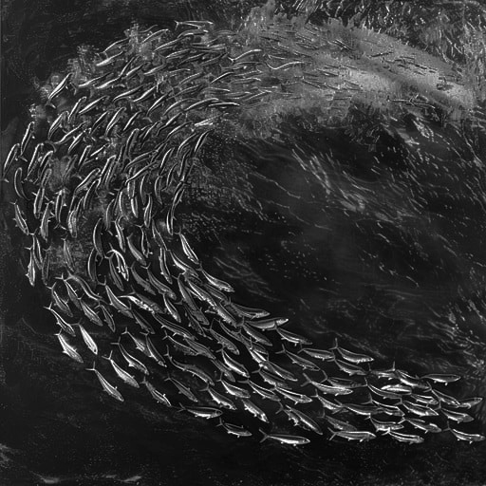
Conclusion
PSO is a powerful algorithm inspired by nature and teamwork.
It shows how simple cooperation between many agents can lead to smart, global solutions —
just like fish swimming together in
harmony to find the best direction.

Slide 12
Short Ending Analogy
Imagine you and your friends searching for the brightest light in the dark.
You share what you find and move together toward the brightest spot —
that’s what PSO does: collective learning and cooperation.

Slide 13

Thanks
Do you have any questions?

