Slide 1
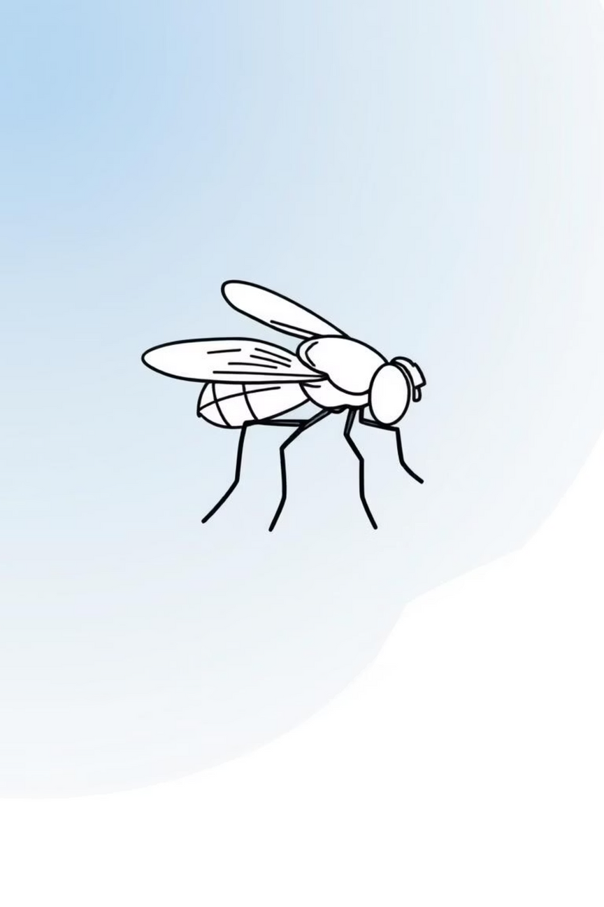

The Fruit Fly Optimization Algorithm (FOA)
LACHELAK RAMI
Notes:
1

Slide 2
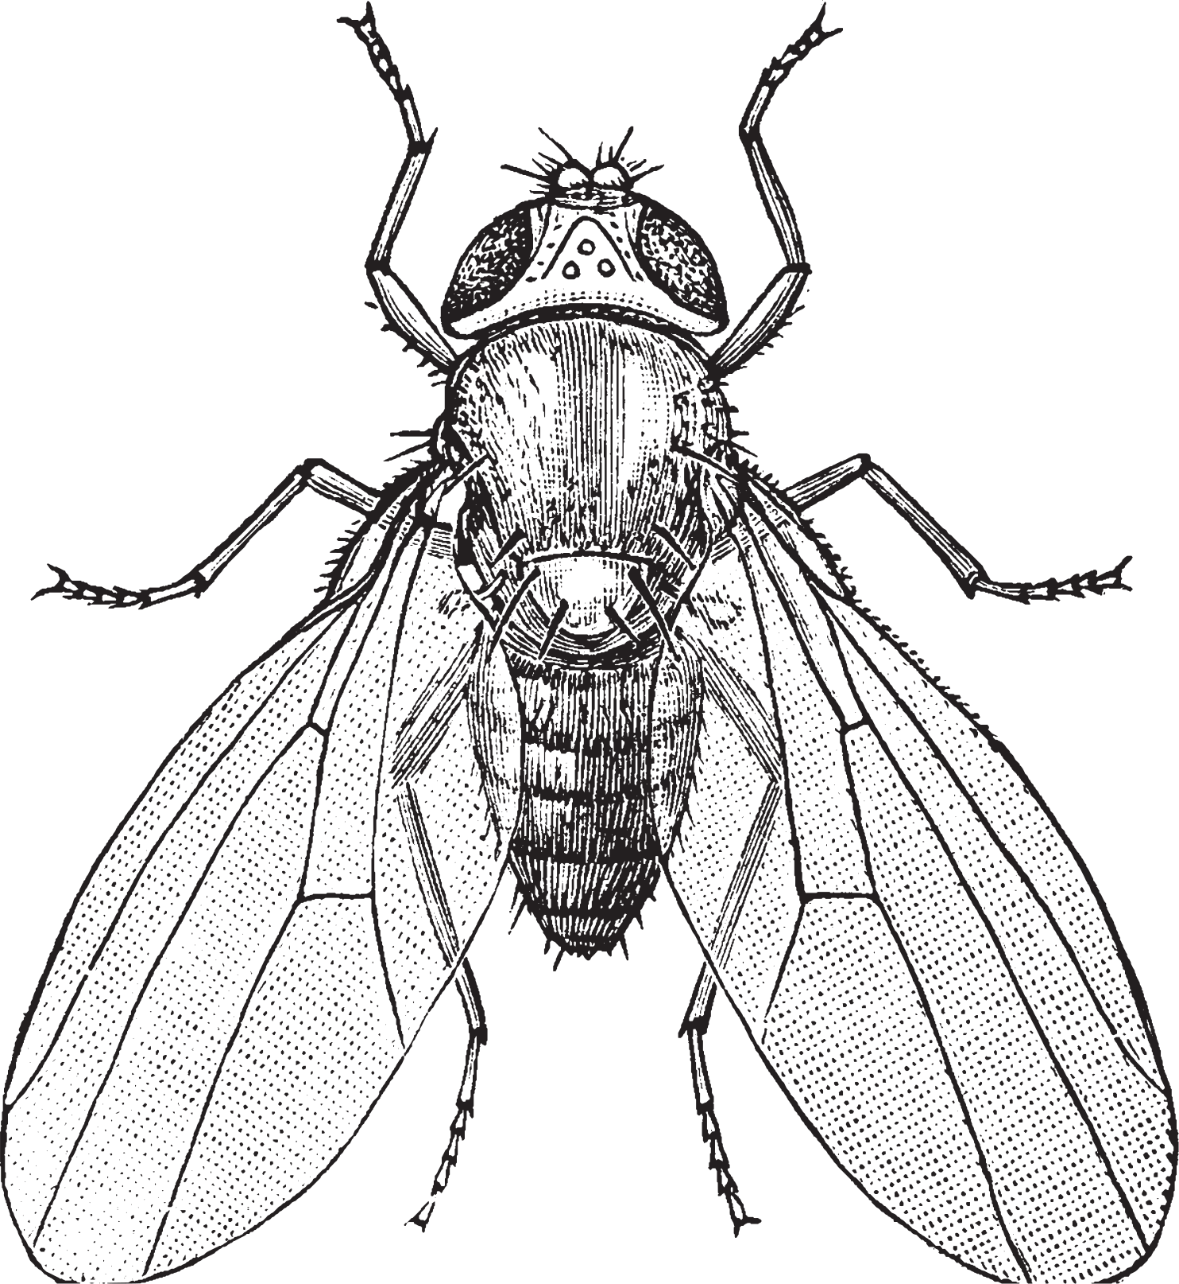
Nature's Inspiration: Biological Aspects
Fruit flies, though tiny, possess remarkable sensory abilities. Their keen sense of smell allows them to detect food sources from considerable distances, guiding them precisely towards sustenance.
Complementing this, their vision assists in navigating and pinpointing the exact location of food once they are in closer proximity. This efficient foraging behaviour in the natural world provides a fascinating blueprint for artificial intelligence.
Notes:
2

Slide 3



Artificial Metaphor: How FOA Works
The Fruit Fly Optimization Algorithm (FOA) cleverly mimics this natural foraging process, translating it into a computational search strategy.
Initial Random Search
Guided Movement
Converging on the Optimum
Each 'fruit fly' in the algorithm represents a potential solution to an optimisation problem. They begin by randomly exploring the search space, much like real fruit flies casting about for the initial scent of food.
Once a fly identifies a promising area (a better solution), it emits a 'scent'. Other flies then converge towards this perceived best location, refining their search efforts collaboratively.
This iterative process of random exploration and guided movement continues, allowing the 'swarm' to collectively converge on the optimal or near-optimal solution.
Notes:
3

Slide 4




Versatile Applications of FOA
FOA's simplicity and effectiveness have led to its adoption across various fields, demonstrating its power in diverse problem-solving scenarios.
Optimisation
Engineering Design
Solving complex problems by finding the best possible solution among a set of alternatives.
Optimising parameters for structures, systems, and product development to achieve peak performance.
Image Processing
Machine Learning Tuning
Enhancing image quality, pattern recognition, and feature extraction through iterative adjustments.
Adjusting hyperparameters of machine learning models for improved accuracy and efficiency.
Notes:
4

Slide 5
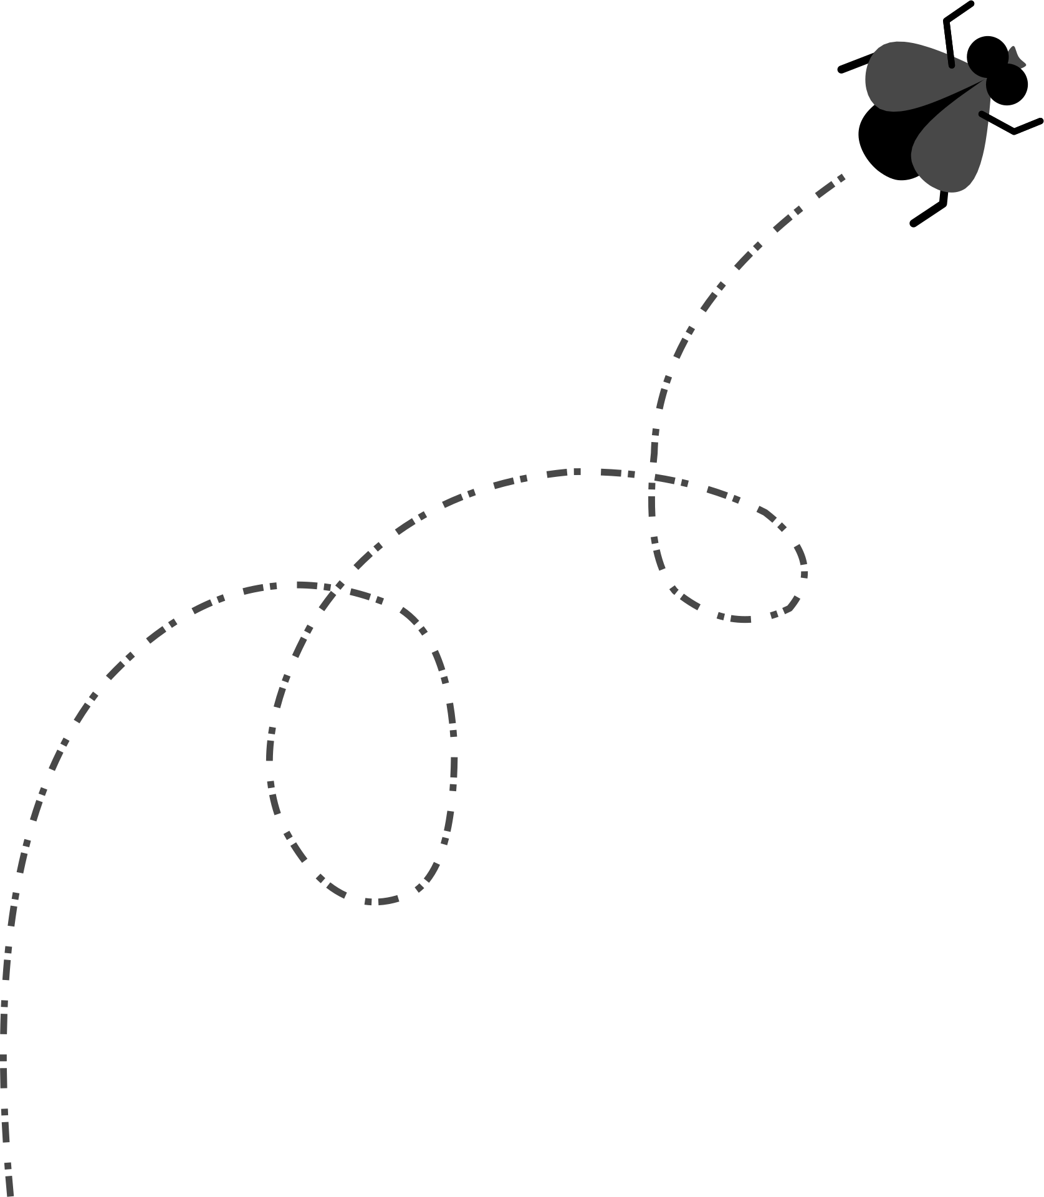
FOA in the Swarm Intelligence Landscape
The Fruit Fly Optimization Algorithm is an integral part of a broader family of computational methods inspired by collective animal behaviour.
Particle Swarm Optimisation (PSO)
Ant Colony Optimisation (ACO)
Inspired by bird flocking and fish schooling.
Models the foraging behaviour of ants.
Artificial Bee Colony (ABC)
Based on the intelligent foraging behaviour of honey bee swarms.
These algorithms share the common principle of emergent intelligence from simple individual interactions.
Notes:
5

Slide 6
The Basic FOA Algorithm: Step-by-Step
Understanding the sequential operations that guide the fruit fly swarm towards the optimal solution.
01
02
Initialise Flies
Random Food Search
Randomly scatter the fruit flies (potential solutions) across the search space.
Each fly then performs a local, random search for a food source, exploring its immediate vicinity.
03
04
Evaluate Fitness (Smell)
Find Best Smell
The 'fitness' (or objective function value) of each fly's current position is calculated, representing the 'smell concentration'.
The algorithm identifies the fly that has found the best 'smell' (the most optimal solution) among the entire swarm.
05
06
Move Towards Best
Repeat Until Convergence
All other flies then adjust their positions, moving towards the location of the fly with the best 'smell'.
This process iterates until a predefined stopping criterion is met, typically when solutions no longer significantly improve.
Notes:
6

Slide 7
Python Example: Minimising x³
A simple Python implementation demonstrates FOA's ability to find the minimum value of a function.
import random
# Function to minimize
def f(x):
return x**3 # Minimum tends toward negative values
# Start at a random position
best_x = random.uniform(-10, 10)
best_f = f(best_x)
# Simple FOA search
for step in range(10):
x = best_x + random.uniform(-1, 1) # Random movement
value = f(x)
if value < best_f: # If new position is better
best_x = x
best_f = value
print("Step", step+1, "→ x =", round(best_x, 3), "f(x) =", round(best_f, 3))
print("\nBest solution found: x =", round(best_x, 3))
Notes:
7

Slide 8
Output Example: Tracing the Optimisation
Observe how the algorithm iteratively refines its search to converge on the optimal solution for f(x) = x³.
Step 1 → x = -3.52 f(x) = 12.41
Step 2 → x = -2.84 f(x) = 8.09
Step 3 → x = -0.30 f(x) = 0.09
...
Step 10 → x = 0.00 f(x) = 0.00
Best solution found: x = 0.00
This demonstrates FOA's effectiveness in swiftly navigating towards the global minimum of the function.
Notes:
8

Slide 9
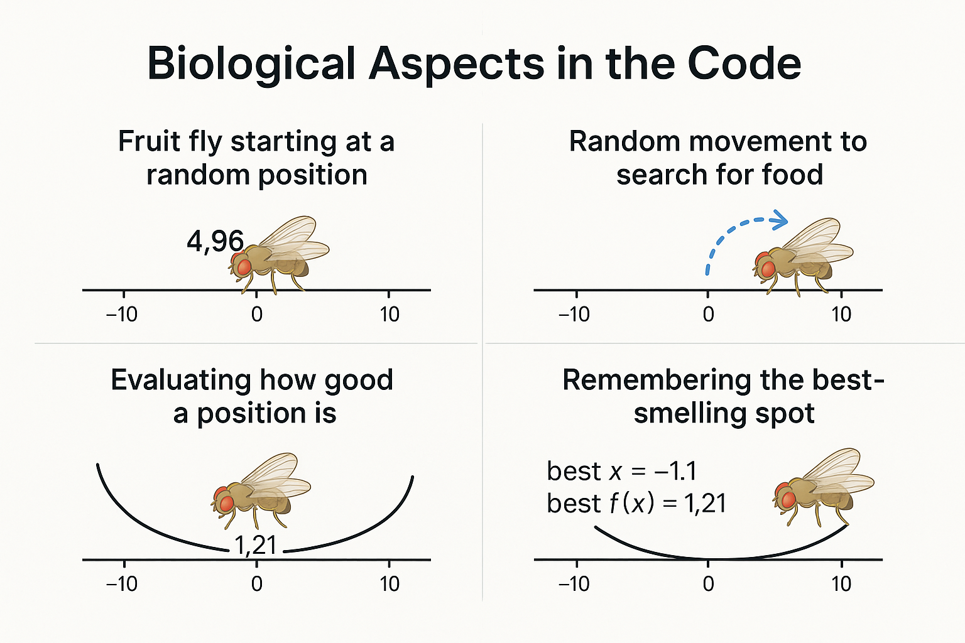
Biological Aspects Represent in The Code
This graphic illustrates how a fruit fly explores the environment and moves toward the best-smelling position.

Slide 10
Advantages and Limitations
Advantages
Limitations
  Simple to understand and implement.
  May struggle with high-dimensional problems.
  Fewer parameters to tune compared to other algorithms.
  Can converge slowly on complex, multi-modal landscapes.
  Effective for various continuous optimisation problems.
  Performance can be sensitive to initial parameters and search range.
  Good at finding global optima in certain search spaces.
  Risk of premature convergence to local optima if not carefully managed.
Notes:
9

Slide 11

Further Reading and References
Pan, W.-T. (2011). A new Fruit Fly Optimization Algorithm. Knowledge-Based Systems, 26, 69–74.
Notes:
10

Slide 12
Thank You for Your Attention
Notes:
11

