Slide 1


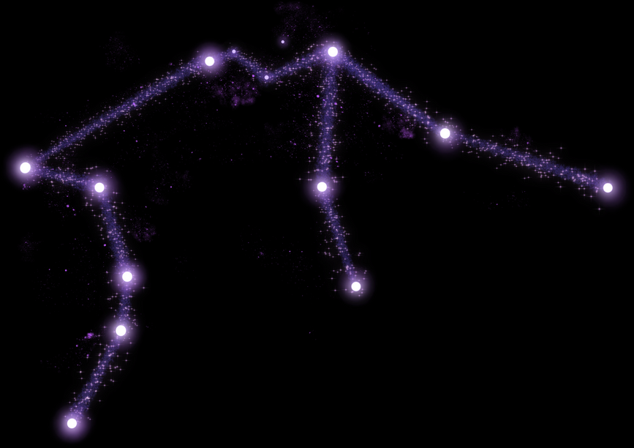






University Badji-Mokhtar . Annaba
Faculty of Technology
ILC_M2
BUTTERFLY OPTIMIZATION ALGORITHM
Presented by
Sadat Litissia

Slide 2
\
Overview
Introduction
Existing BOA-Based Algorithms
Biological Aspects
Details of the Basic Algorithm
Artificial Metaphor Behind BOA
Example UAV Trajectory Planning
Application Domains
Strengths & Weaknesses
Conclusion

Slide 3

Introduction
Optimization is a key challenge in many fields. Some problems—like scheduling or path planning—are too complex for traditional methods. This led to the creation of nature-inspired algorithms that mimic smart behaviors found in nature to find good solutions.
The Butterfly Optimization Algorithm (BOA) is a recent metaheuristic inspired by how butterflies use fragrant pheromones to communicate and locate resources. BOA models this behavior to perform efficient global search and local exploration, making it useful for a wide range of real-world optimization tasks.

Slide 4


t
Biological Aspects
Butterflies interact using scents (pheromones).
The intensity of the scent depends on:
• environment conditions,
• the butterfly’s energy,
• the distance from others.
Butterflies exhibit two behaviors:
• moving toward stronger scents,
• or performing random movements when no strong scent is detected.

Slide 5
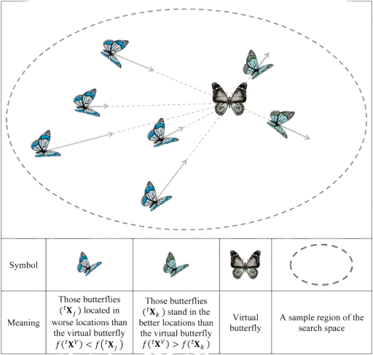
t
Artificial Metaphor Behind BOA
In the Butterfly Optimization Algorithm (BOA), the biological behavior of butterflies is translated into an artificial search mechanism:
• Each butterfly represents a candidate solution.
• The fragrance emitted by a butterfly corresponds to the fitness value of that solution.
• Moving toward the best butterfly models exploitation, where the algorithm intensively searches around promising areas.
• Random movement represents exploration, allowing the search to escape local optima and discover new regions of the solution space.
A switching probability p controls the balance between global and local search. At each iteration, the algorithm decides based on p whether butterflies perform a global exploration step or a local exploitation step.

Slide 6

t
Application Domains
BOA has been successfully applied in:
• structural optimization,
• feature selection in machine learning,
• neural network training,
• UAV path planning and robotics,
• energy systems,
• scheduling and routing,
• biomedical signal processing.

Slide 7

Existing BOA-Based Algorithms
Several variants have been developed to improve performance:
Chaotic BOA
Original BOA
Improved BOA (IBOA)
Quantum-based BOA
Adaptive BOA

Slide 8
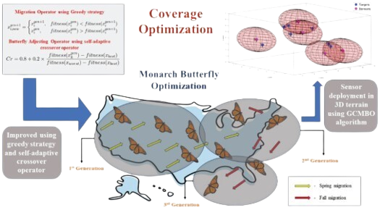
t
Details of the Basic Algorithm
Fragrance computation
f = c × I^a
where I is the fitness, and c and a are sensory parameters
Global search
Butterfly moves toward the best solution.
Local search
Butterfly moves randomly using the positions of two neighboring butterflies.

Slide 9
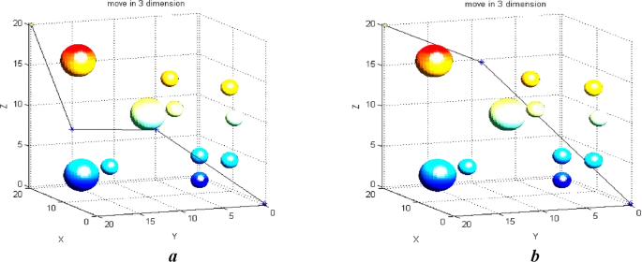
t
Example – UAV Trajectory Planning
UAV (drone) path planning aims to compute the best route that:
• avoids obstacles,
• minimizes total flight distance,
• reduces energy consumption.
In this problem, BOA evaluates possible flight paths as candidate solutions.
Experiments show that BOA achieves the lowest path cost in the best-case scenario, outperforming:
• Ant Colony Optimization (ACO),
• Particle Swarm Optimization (PSO).

Slide 10
Strengths & Weaknesses
Weaknesses
• May prematurely converge if the switching probability is not well tuned.
• Local search may be weak in complex landscapes.
• Performance strongly depends on parameter settings (a, c, p).
• Sometimes less stable than older, more mature algorithms (GA, PSO) for noisy problems.
• No built-in memory mechanism like in PSO (particles remember best positions).
Strengths
• Simple and easy to implement, with few parameters.
• Fast convergence due to the strong global movement mechanism.
• Good balance between exploration and exploitation.
• Works well in high-dimensional spaces (feature selection, path planning).
• Flexible and easily hybridized with other algorithms (PSO–BOA, CNN–BOA, GA–BOA).

Slide 11
Conclusion
The Butterfly Optimization Algorithm is a fast and flexible method for solving complex optimization problems.
It performs well in tasks like feature selection and UAV path planning. Despite some limits such as parameter sensitivity, BOA and its improved versions remain powerful and promising tools for future intelligent optimization.

Slide 12

THANK YOU

